Slide 1

Exam AZ-303: Microsoft Azure Architect Technologies Crash Course
Tim Warner

Slide 2


Tim Warner
Based in Nashville, TN, US
MCT, MVP
Twitter: @TechTrainerTim
Badge: timw.info

Slide 3
Course Materials
timw.info/az303

Slide 4
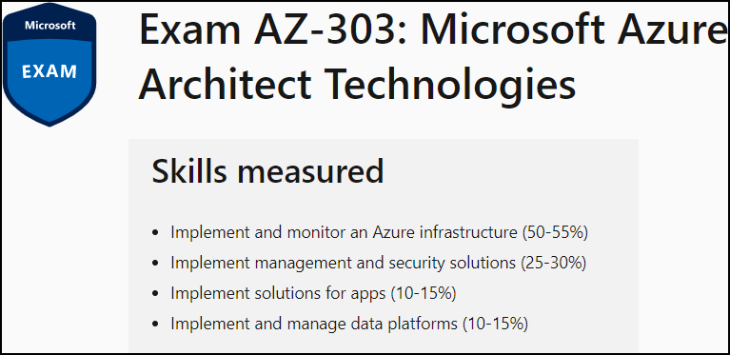
Learning Goals
Day 1
Day 2

Slide 5
Setting Expectations
Azure Architect is an expert-level certification
You should already know how to deploy and configure Azure resources
This is a "crash course"
Please plan to review these materials more than once
Recording takes ~24 hours to process
Five-minute break at midpoint
Please ask/answer questions and provide feedback in the Q/A panel, not the group chat

Slide 6
2020 Exam Update Information
Microsoft Worldwide Learning (WWL) revisits the Azure role-based certs yearly
Relevant blog post: timw.info/az2020
AZ-303 is available now
AZ-300 retires around September 30, 2020

Slide 7
Tim's Certification Study Pyramid
Interdependence
Content knowledge
Practical application
Test-taking skills

Slide 8
Migration and Disaster Recovery

Slide 9
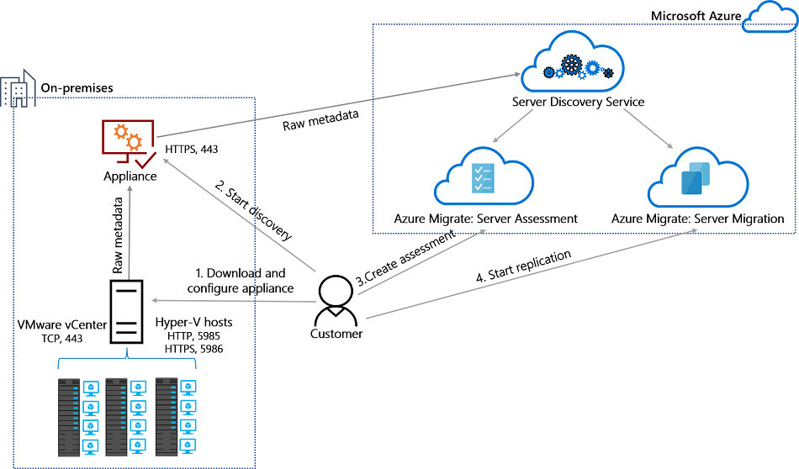
Azure Migrate

Slide 10

Azure Backup

Slide 11

Azure Site Recovery

Slide 12
Load Balancing

Slide 13

VM Networking

Slide 14

Load Balancing

Slide 15

VNet Peering

Slide 16

Hybrid Networking

Slide 17

Network Virtual Appliance

Slide 18

Azure Load Balancer

Slide 19

Application Gateway

Slide 20

Traffic Manager

Slide 21

Front Door Service

Slide 22
Governance

Slide 23

Tenant vs. Subscription

Slide 24

Azure Management Scopes
/ Tenant Root

Slide 25
App Architecture

Slide 26


Docker Container Lifecycle
https://timw.info/3635f

Slide 27

Event Architecture

Slide 28
Data Platform

Slide 29

Always Encrypted

Slide 30
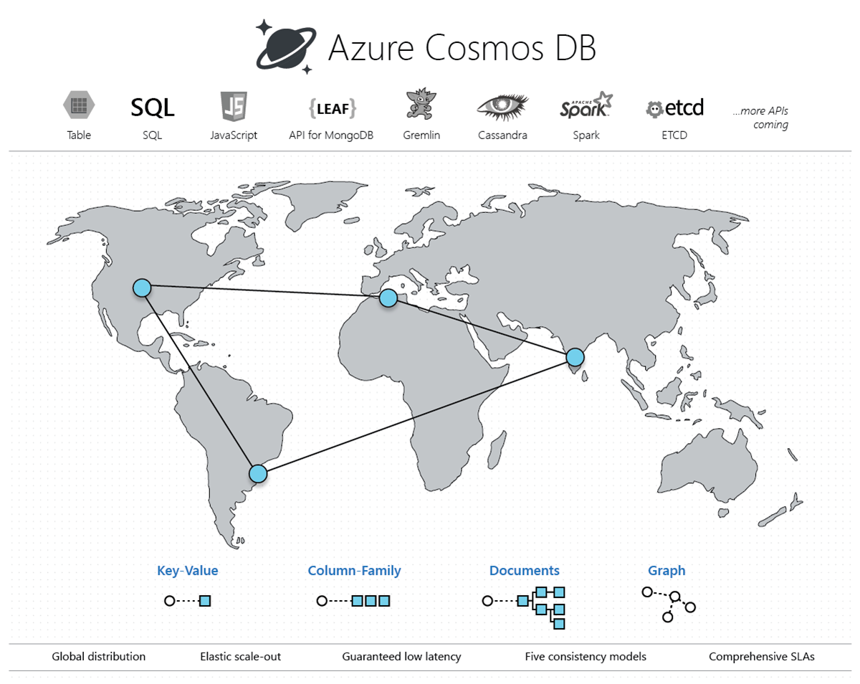
Cosmos DB

Slide 31
Exam AZ-303 Item Types

Slide 32

Multiple Choice

Slide 33
Repeated Scenario
You need to move an Azure VM to another hardware host.
Solution: You redeploy the VM.
Does this solution meet the goal?
Yes
No

Slide 34

Select and Place

Slide 35

Build List and Reorder

Slide 36

Active Screen/Fill in the Blank

Slide 37

Case Study

Slide 38






Performance-Based Lab

Slide 39
Microsoft Online Testing

Slide 40
Microsoft Online Testing Process
timw.info/online

Slide 41

Microsoft Online Testing Process

Slide 42

Microsoft Online Testing Process

Slide 43

Microsoft Online Testing Process

Slide 44

Microsoft Online Testing Process

Slide 45

Microsoft Online Testing Process

Slide 46

Microsoft Online Testing Process

Slide 47

Microsoft Online Testing Process

Slide 48
AZ-303 Exam Strategy
Focus your skills accordingly:
60 percent Azure portal
20 percent Azure PowerShell
10 percent Azure CLI
10 percent KQL
Expect performance-based labs, but be thankful if you don't see 'em

Slide 49
Thank you!
Course materials: timw.info/az303
Twitter: @TechTrainerTim
Work: timw.info/ps
Web: TechTrainerTim.com

Slide 50
Authentication

Slide 51

Hybrid Identity

Slide 52

Passthrough Authentication

Slide 53

Seamless Single Sign-on

Slide 54
Azure Storage

Slide 55
Storage Account Replication
1
3
3
2
LRS
ZRS

Slide 56
Storage Account Replication
1
3
1
3
2
2
GRS – RA/GRS

Slide 57
Azure Compute

Slide 58
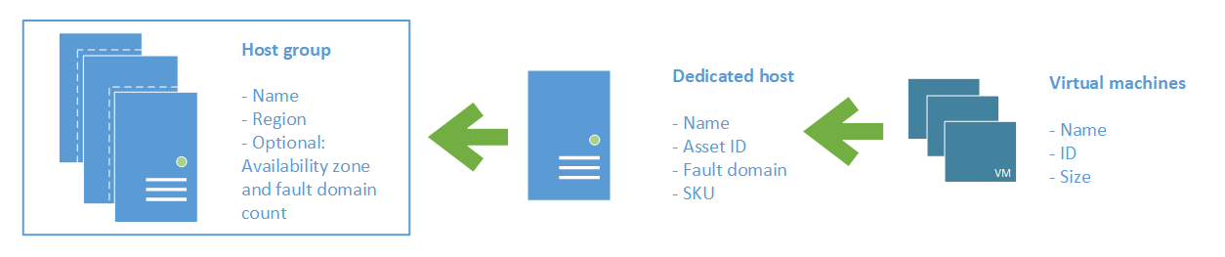
Azure VM Dedicated Host

Slide 59
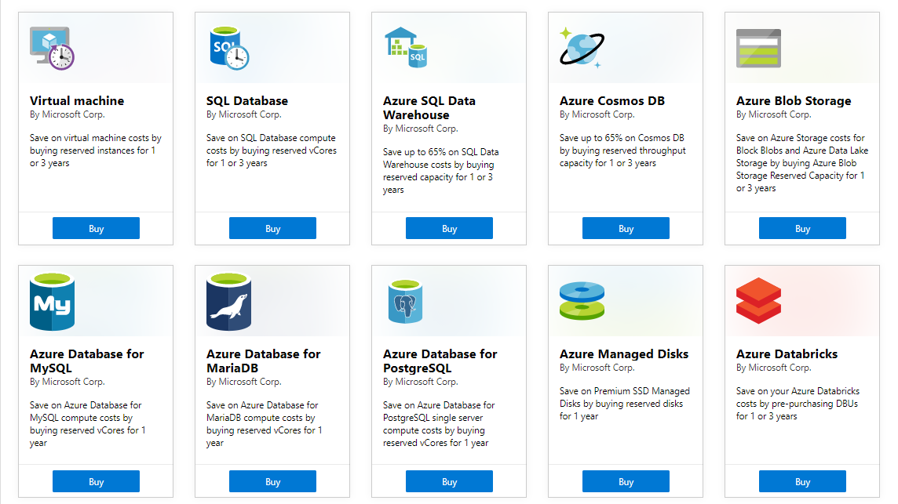
Azure Reservations

Slide 60

VM Scale Sets

Slide 61
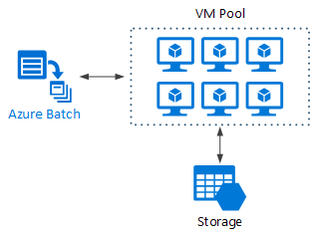
Azure Batch

Slide 62

Availability Set

Slide 63

Availability Zone

